Slide 1
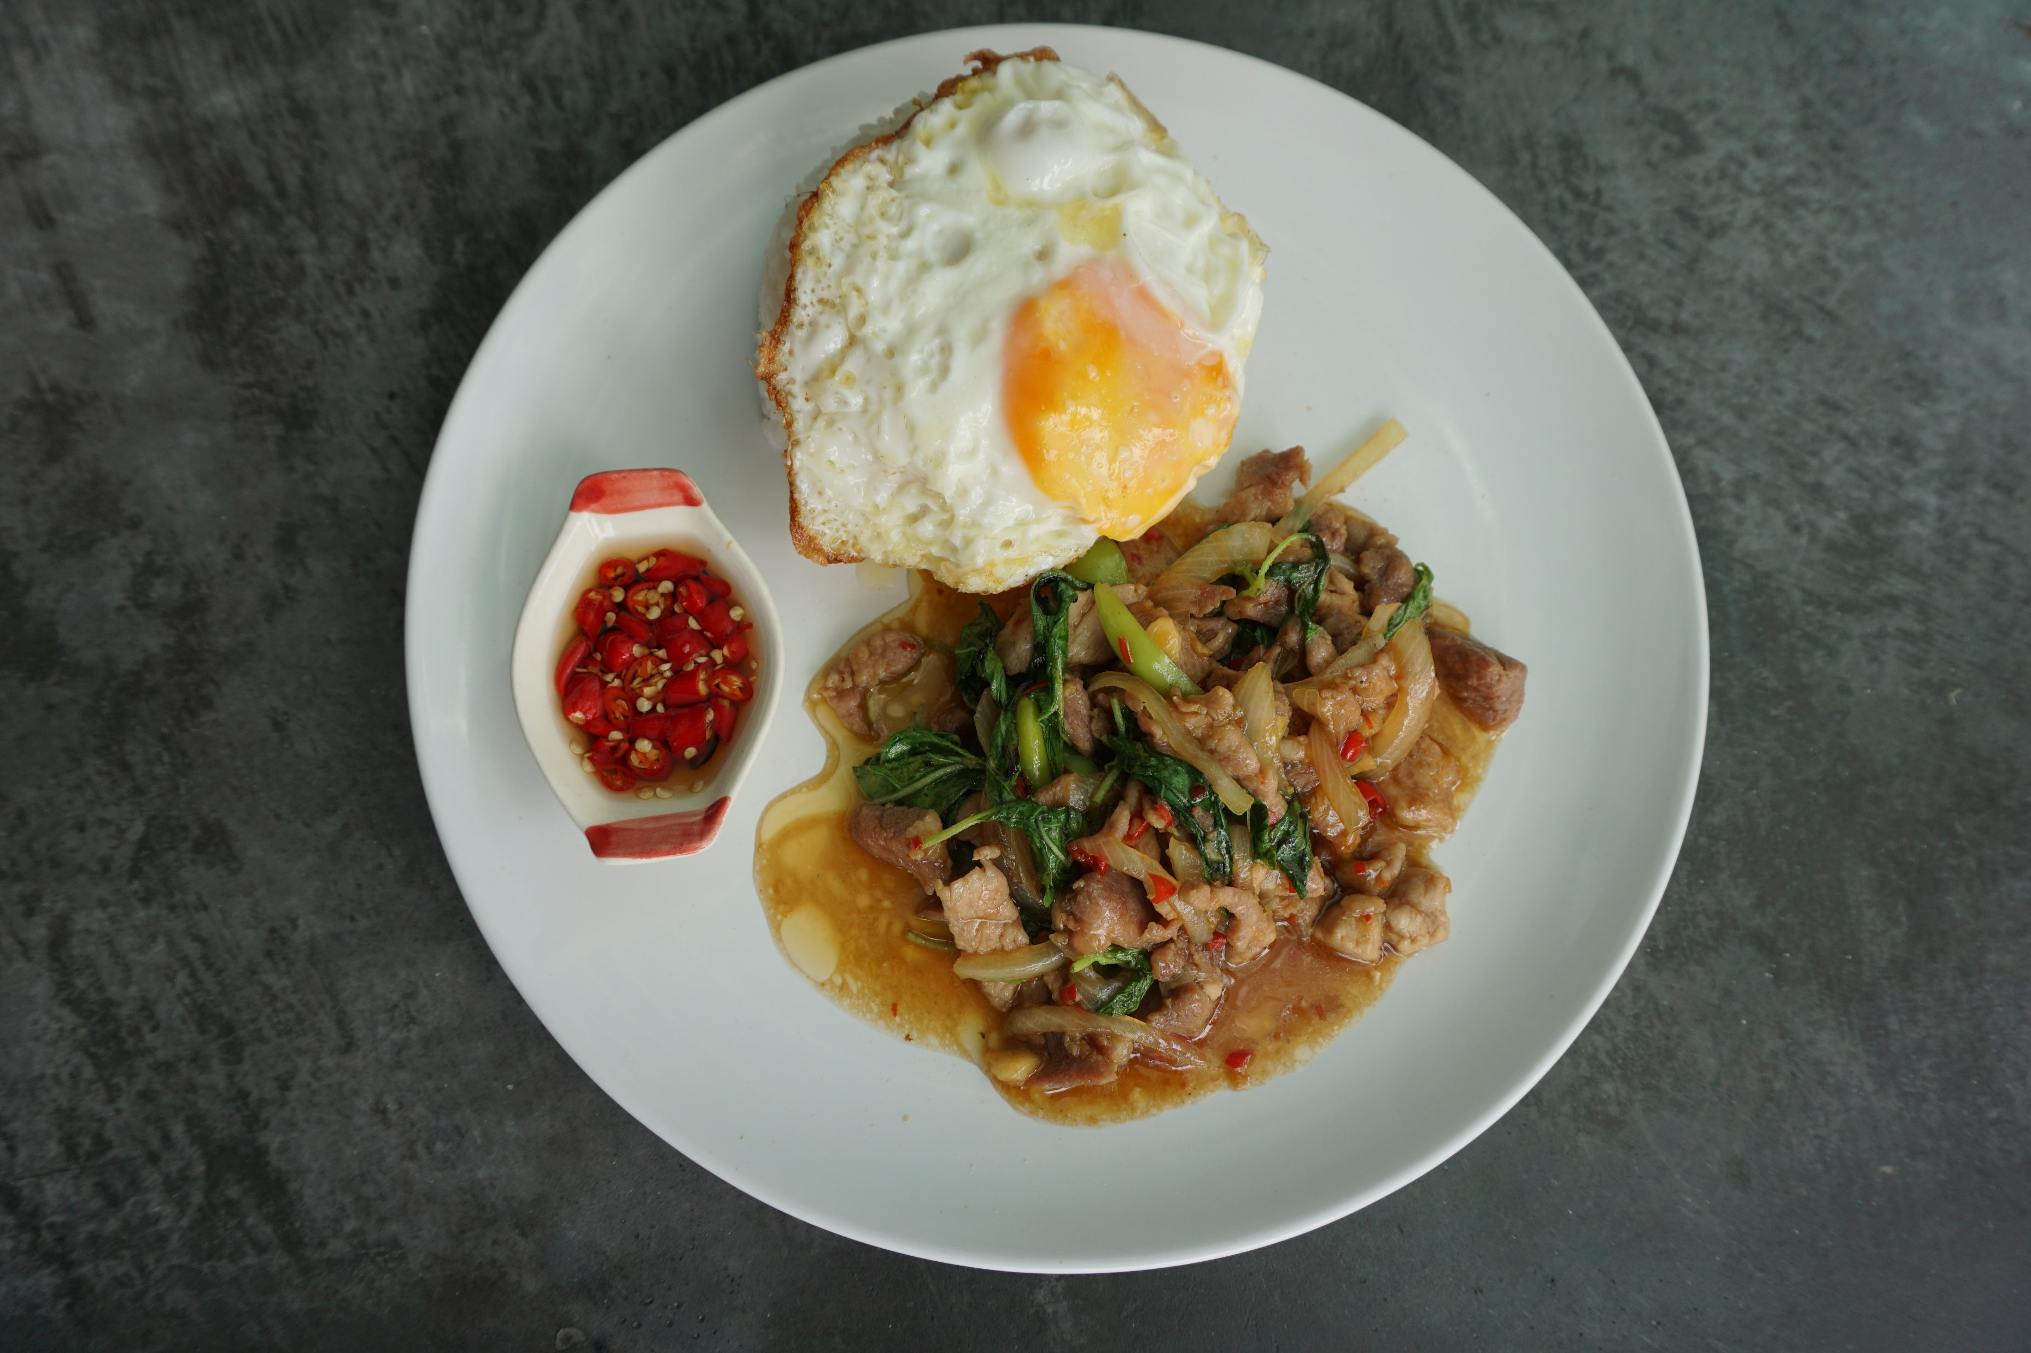
Project: Thai Food Recognition
ITCS476 – DIGITAL IMAGE PROCESSING
6088146 ◾ 6088221

Slide 2
TODAY’S AGENDA
Introduction Problem Domain Objective Outcomes To-dos

Slide 3
Introduction
Problem Domain Objective Outcomes To-dos

Slide 4
Introduction
Problem Domain Objective Outcomes To-dos
For most foreigners and some Thai people, remembering and identifying local menus and dishes proves to be troublesome since there are too many variations of the same food depending on the region and the individual. In fact, this is because there is no absolute correct method to cook any food.

Slide 5
Introduction
Problem Domain Objective Outcomes To-dos
For most foreigners and some Thai people, remembering and identifying local menus and dishes proves to be troublesome since there are too many variations of the same food depending on the region and the individual. In fact, this is because there is no absolute correct method to cook any food.

Slide 6
Introduction
For most foreigners and some Thai people, remembering and identifying local menus and dishes proves to be troublesome since there are too many variations of the same food depending on the region and the individual. In fact, this is because there is no absolute correct method to cook any food.
Problem Domain Objective Outcomes To-dos

Slide 7
Problem Domain
Objective Outcomes To-dos

Slide 8
Problem Domain
Objective Outcomes To-dos
We are focusing on classifying certain types of foods that can be easily found within or near Mahidol University.
There are totally 38 classes of foods each of which has 250 images.

Slide 9
Problem Domain
We are focusing on classifying certain types of foods that can be easily found within or near Mahidol University.
There are totally 38 classes of foods each of which has 250 images.
Objective Outcomes To-dos
MAFood-121
THE UNIVERSITY OF BARCELONA
21,175 images of foods from various cuisine styles
ThaiFoodDataset
Ukrit Tiankaew & Peerapon Chunpongthong
13 types of foods each of which has 400 images.
ThaiRandFood
OUR DATASET
Our efforts to capture food images found near the Salaya campus.

Slide 10
Problem Domain Datasets
We are focusing on classifying certain types of foods that can be easily found within or near Mahidol University.
There are totally 38 classes of foods each of which has 250 images.
Objective Outcomes To-dos
MAFood-121
THE UNIVERSITY OF BARCELONA
21,175 images of foods from various cuisine styles
ThaiFoodDataset
Ukrit Tiankaew & Peerapon Chunpongthong
13 types of foods each of which has 400 images.
ThaiRandFood
OUR DATASET
Our efforts to capture food images found near the Salaya campus.

Slide 11
Problem Domain
Objective Outcomes To-dos
38 classes
barbecued_red_pork_in_sauce_with_rice caesar_salad charcoal-boiled_pork_neck chow_mein coconut_milk_soup crispy_pork_with_kale_with_rice fried_chicken_with_rice fried_mussel_pancakes fried_pork_with_rice fried_rice green_curry hamburger hot_and_sour_fish_and_vegetable_ragout kebab khao_soi noodles noodles_without_soup noodles_with_fish_curry omelette onion_rings pad_see_ew pad_thai peking_duck pizza rice_crispy_pork rice_topped_with_stir_fried_meat_and_basil spaghetti_bolognese spaghetti_carbonara spicy_chicken_salad_with_rice spicy_stir_fried_pork_with_red_curry_paste spring_rolls steak steak_with_rice steamed_chicken_with_rice steamed_rice_roll stewed_pork_leg thai_papaya_salad yellow_curry
MAFood-121
THE UNIVERSITY OF BARCELONA
21,175 images of foods from various cuisine styles
ThaiFoodDataset
Ukrit Tiankaew & Peerapon Chunpongthong
13 types of foods each of which has 400 images.
ThaiRandFood
OUR DATASET
Our efforts to capture food images found near the Salaya campus.

Slide 12
Problem Domain
38 classes
barbecued_red_pork_in_sauce_with_rice caesar_salad charcoal-boiled_pork_neck chow_mein coconut_milk_soup crispy_pork_with_kale_with_rice fried_chicken_with_rice fried_mussel_pancakes fried_pork_with_rice fried_rice green_curry hamburger hot_and_sour_fish_and_vegetable_ragout kebab khao_soi noodles noodles_without_soup noodles_with_fish_curry omelette onion_rings pad_see_ew pad_thai peking_duck pizza rice_crispy_pork rice_topped_with_stir_fried_meat_and_basil spaghetti_bolognese spaghetti_carbonara spicy_chicken_salad_with_rice spicy_stir_fried_pork_with_red_curry_paste spring_rolls steak steak_with_rice steamed_chicken_with_rice steamed_rice_roll stewed_pork_leg thai_papaya_salad yellow_curry
Objective Outcomes To-dos

Slide 13
Objective
Outcomes To-dos
#1
To implement a Thai food image classifier.
#2
To create a dataset for Thai food images.
#3
To explore a suitable methodology to build a classifier.

Slide 14
Objective
Outcomes To-dos
#1
To implement a Thai food image classifier.
#2
To create a dataset for Thai food images.
#3
To conduct a comparative study between manual and learning-based feature extraction.

Slide 15
Outcomes
Outcomes To-dos
To-dos
#1
To implement a Thai food image classifier.
#2
To create a dataset for Thai food images.
#3
To conduct a comparative study between manual and learning-based feature extraction.

Slide 16
Outcomes Approaches
To-dos
Manual Feature Extraction with Euclidean Distance
Pretrained ResNet-50
+ SVM classifier
#1
To implement a Thai food image classifier.
#2
To create a dataset for Thai food images.
#3
To conduct a comparative study between manual and learning-based feature extraction.

Slide 17
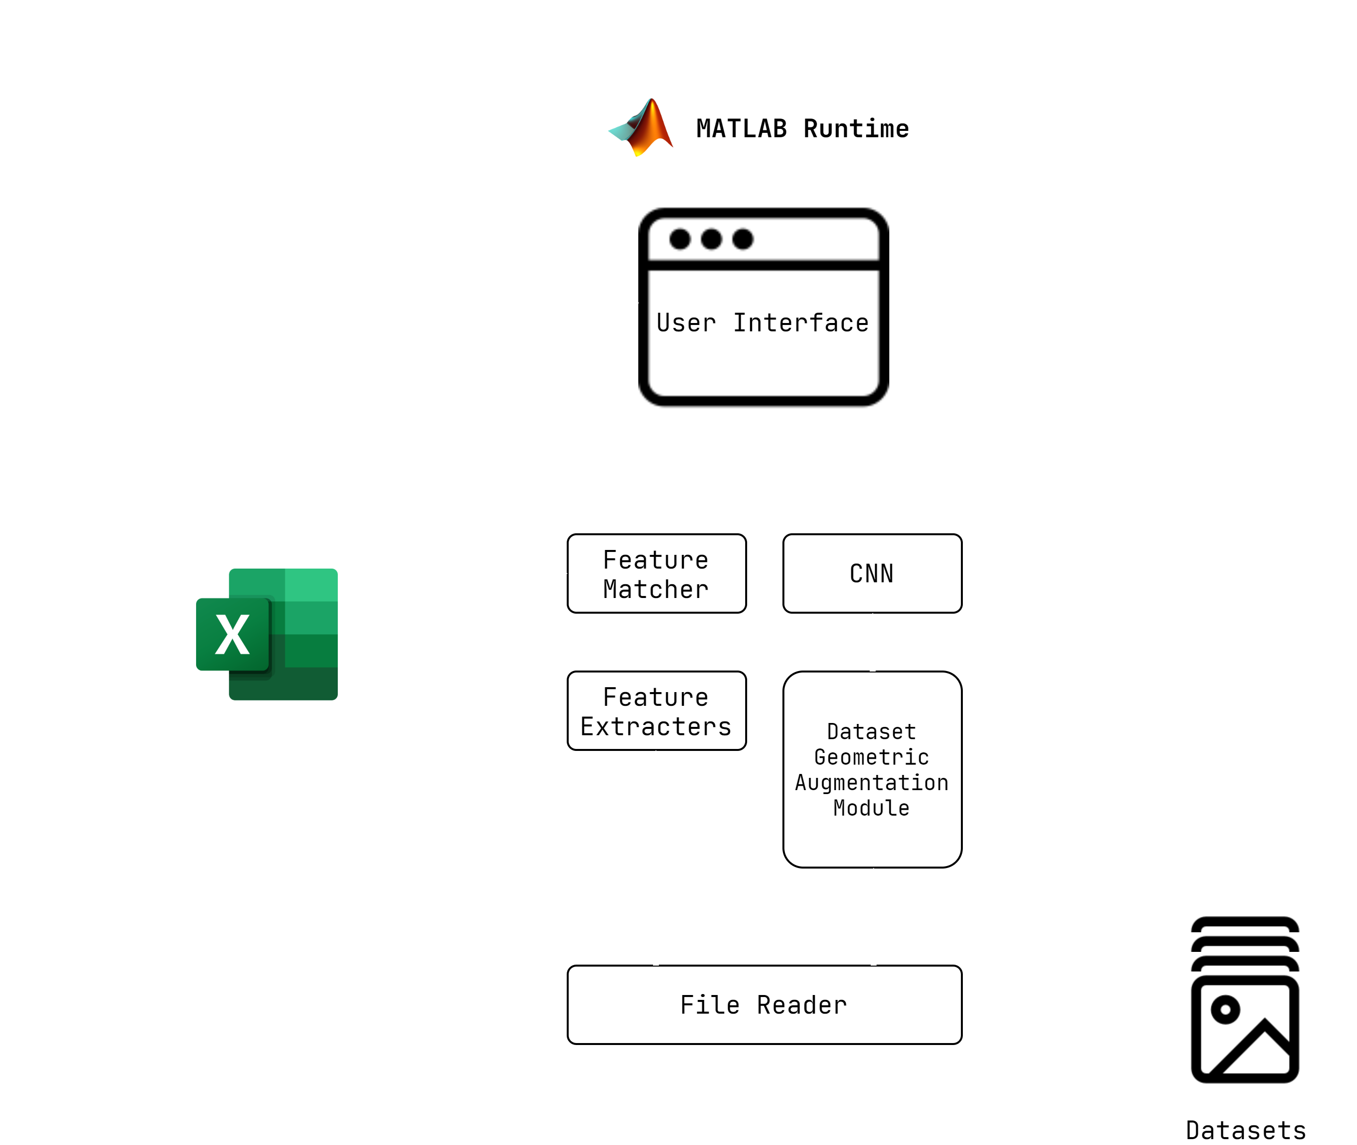
Outcomes Approaches
To-dos
Manual Feature Extraction Pretrained ResNet-50
Manual Feature Extraction with Euclidean Distance
Pretrained ResNet-50
+ SVM classifier

Slide 18
Outcomes Approaches
To-dos
Manual Feature Extraction Pretrained ResNet-50
Some of the extracted features are:
Average Color Level in each Channel
Mean Gray level
Black area size
Edge Area size
Texture Features
Entropy
Energy
Contrast
Correlation
Homogeneity
Manual Feature Extraction with Euclidean Distance
Pretrained ResNet-50
+ SVM classifier
For each dataset image, computed these & stored in an Excel file for a subsequent classification

Slide 19
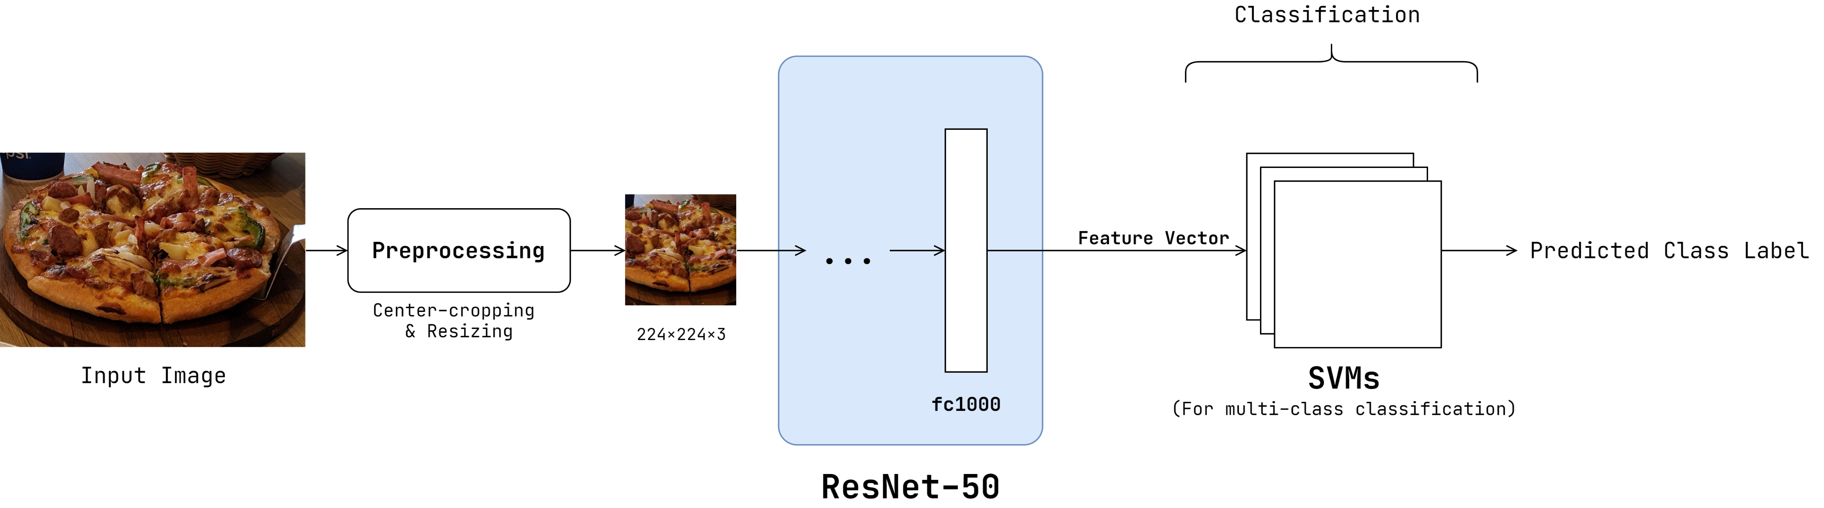
Outcomes Approaches
To-dos
Manual Feature Extraction Pretrained ResNet-50
Manual Feature Extraction with Euclidean Distance
Pretrained ResNet-50
+ SVM classifier

Slide 20
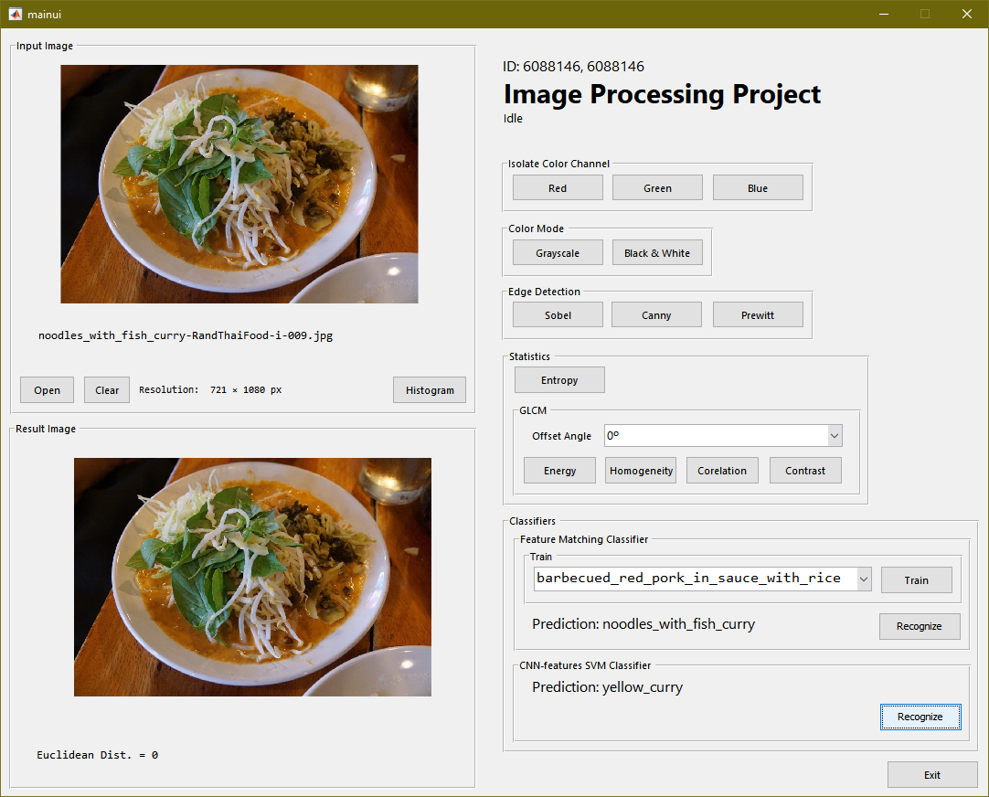
Outcomes Screenshot
To-dos
Manual Feature Extraction with Euclidean Distance
Pretrained ResNet-50
+ SVM classifier

Slide 21
Outcomes Results
To-dos
Manual Feature Extraction with Euclidean Distance
Pretrained ResNet-50
+ SVM classifier
METHOD | ACCURACY | PRECISION | RECALL | F1
Manual Feature Extraction | 11.89% | 11.61% | 11.89% | 11.68%
ResNet-50 with SVM | 74.6% | 77.37% | 74.6% | 74.28%

Slide 22
To-dos

Slide 23
To-dos Future Improvements
To-dos
IMPLEMENTATION
Switch to Python programming language for further community supports.
DATASET
Increase the number of images per dataset
CLASSIFIER
Continue training a CNN with some extent of geometric image augmentation to improve classification performance.

Slide 24
Thank you!

